Slide 1
SENSORS & ACTUATORS

Slide 2
In any control system, sensors provide measurements of important variables in a format suitable for the digital microcontroller.
Similarly, actuators are electrically operated devices that regulate inputs to the plant that directly control its output.
For example, fuel injectors are electrically driven actuators that regulate the flow of fuel into an engine for engine control applications.

Slide 3
A sensor is a device that produces a measurable signal in response to a stimulus.
The characteristics of a sensor may be classified as being either static, or dynamic.

Slide 4
Static characteristics are those that can be measured after all transient effects have stabilized to their final or steady state.
They address questions such as; by how much did the sensor’s output change in response to the input?
what is the smallest change in the input that will give an output reading? and
how long did it take for the output value to change to the present value?

Slide 5
Dynamic characteristics describe the sensor’s transient properties.
These typically address questions such as; at what rate is the output changing in response to the input? and
what impact would a slight change in the input conditions have on the transient response?

Slide 6
Accuracy:
This defines how correctly the sensor output represents the true value. In order to assess the accuracy of a sensor, either the measurement should be benchmarked against a standard measure and or the output should be compared with a measurement system with a known accuracy.
For instance, an oxygen gas sensor, which operates at a room with 21% oxygen concentration, the gas measurement system is more accurate if it shows 21.1% rather than 20.1% or 22%.

Slide 7
Error:
It is the difference between the true value of the quantity being measured and the actual value obtained from the sensor.
For instance, in the gas sensing example, if we are measuring the oxygen content in the room having exactly 21% oxygen, and our sensor gives us a value of 21.05%, then the error would be 0.05%.

Slide 8
The set of variables sensed for any given engine is specific to the associated engine control configuration.
The superset of variables sensed in engine control includes the following:
1. Mass air flow (MAF) rate
2. Exhaust gas oxygen concentration (possibly heated)
3. Throttle plate angular position
4. Crankshaft angular position/RPM
5. Coolant temperature
6. Intake air temperature
7. Manifold absolute pressure (MAP)
8. Differential exhaust gas pressure
9. Vehicle speed
10. Transmission gear selector position

Slide 9
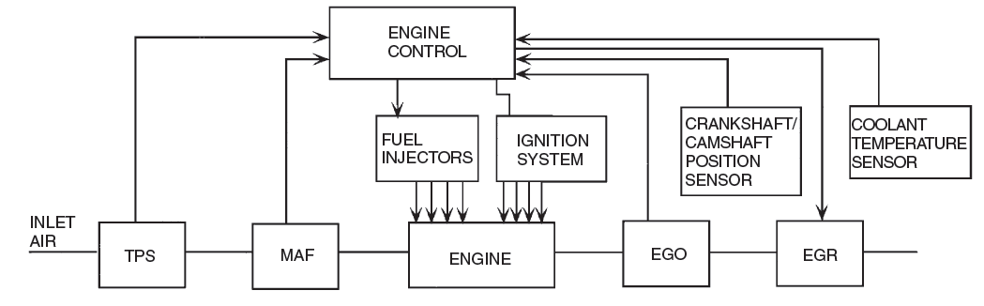
Typical Electronic Engine Control System

Slide 10
ENGINE CRANKSHAFT ANGULAR POSITION SENSOR
Besides pressure, the position of shafts, valves, and levers must be sensed for automotive control systems.
Magnetic means of such measurements are generally preferred in engine applications since they are unaffected by oil, dirt, or other contaminants.
The principles involved in measuring rotating shafts can be illustrated by one of the most significant applications for engine control: the measurement of crankshaft angular position or angular velocity.

Slide 11
Imagine the engine as viewed from the rear, on the rear of the crankshaft is a large, heavy, circular steel disk called the flywheel that is connected to and rotates with the crankshaft.
Let’s mark a point on the flywheel, and draw a line through this point and the axis of rotation.
Let’s draw another line through the axis of rotation parallel to the horizontal center line of the engine as a reference line.
The crankshaft angular position is the angle between the reference line and the mark on the flywheel.

Slide 12
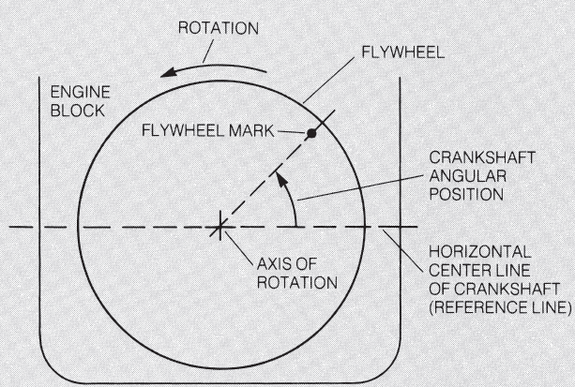
Engine Crankshaft Angular Position Measurement

Slide 13
Imagine that the flywheel is rotated so that the mark is directly on the reference line. This is an angular position of zero degrees.
For our purposes, assume that this angular position corresponds to the No. 1 cylinder at TDC (top dead center).
As the crankshaft rotates, this angle increases from zero to 360° in one revolution.
However, one full engine cycle from intake through exhaust requires two complete revolutions of the crankshaft.

Slide 14
That is, one complete engine cycle corresponds to the crankshaft angular position going from zero to 720°.
During each cycle, it is important to measure the crankshaft position with reference to TDC for each cylinder.
This information is used by the electronic engine controller to set ignition timing and, in most cases, to set the fuel injector pulse timing.
In automobiles with electronic engine control systems, angular position can be sensed on the crankshaft directly or on the camshaft.

Slide 15
The camshaft rotational speed is one-half that of the crankshaft, so the camshaft angular position goes from zero to 360° for one complete engine cycle.
Either of these sensing locations can be used in electronic control systems.
At the present time, there appears to be a trend toward measuring crankshaft position directly rather than indirectly via camshaft position.
In fact, it is sufficient for engine control purposes to measure crankshaft/camshaft position at a small number of fixed points.
The number of such measurements (or samples) is determined by the number of cylinders.

Slide 16
It is desirable to measure engine angular position with a non contacting sensor to avoid mechanical wear and corresponding changes in accuracy of the measurement.
The two most common methods for noncontact coupling to a rotating shaft employ
Magnetic fields or
Optics.

Slide 17
Engine Speed Sensor
Magnetic Reluctance Position Sensor used to measure engine speed. The reluctance sensor is used in this case as an example
This sensor consists of a permanent magnet with a coil of wire wound around it. A steel disk that is mounted on the crankshaft (usually in front of the engine) has tabs that pass between the pole pieces of this magnet.
The steel disk has four protruding tabs, which is appropriate for an 8-cylinder engine.

Slide 18
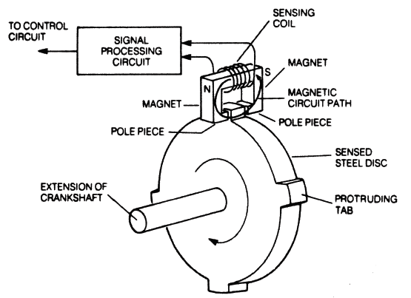
Magnetic Reluctance Crankshaft Position Sensor

Slide 19
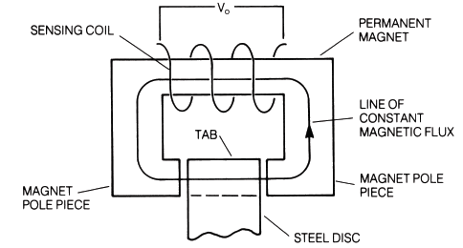
Magnetic Circuit of the Reluctance Sensor

Slide 20
When one of the tabs of the steel disk is located between the pole pieces of the magnet, a large part of the gap between the pole pieces is filled by the steel. Since the steel has a lower reluctance than air, the “flow” of magnetic flux increases to a relatively large value.
On the other hand, when a tab is not between the magnet pole pieces, the gap is filled by air only. This creates a high-reluctance circuit for which the magnetic flux is relatively small.
Thus, the magnitude of the magnetic flux that “flows” through the magnetic circuit depends on the position of the tab, which, in turn, depends on the crankshaft angular position.

Slide 21
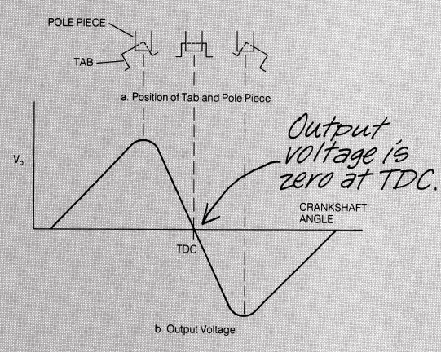
TDC – Top Dead Centre
Output Voltage Waveform from the Magnetic Reluctance Crankshaft Position Sensor Coil

Slide 22
The four tabs will pass through the sensing coil once for each crankshaft revolution. Therefore, if we count the pulses of voltage from the sensing coil in one minute and divide by four, we will know the engine speed in revolutions per minute (RPM).

Slide 23
Timing Sensor for Ignition and Fuel Delivery
In electronic engine control it is often desirable to measure the angular position of the engine relative to a specific point in the cycle.
Normally it is sufficient to measure camshaft position at a fixed point. Such a sample of camshaft position is readily achieved by a magnetic sensor similar to that described for the crankshaft position measurement.
This sensor detects a reference point on the angular position of the camshaft that defines a beginning to a complete engine cycle

Slide 24
Once this reference point has been detected, crankshaft position measurements provide sufficient information for timing fuel injection pulses and ignition.
In one scheme a variable-reluctance sensor is located near a ferromagnetic disk on the camshaft. This disk has a notch cut (or it can have a protruding tab), as shown in Figure

Slide 25
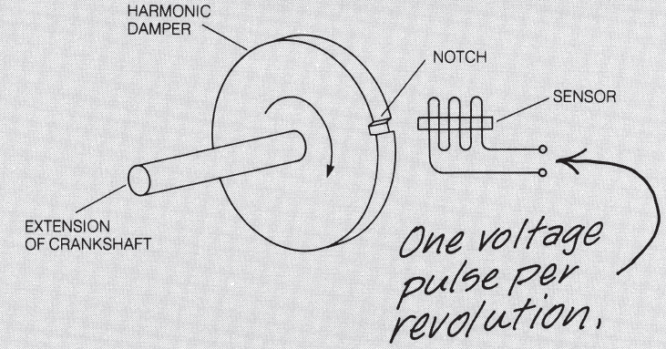
Crankshaft Position Sensor

Slide 26
The disk provides a low-reluctance path (yielding high magnetic flux) except when the notch aligns with the sensor axis.
Whenever the notch aligns with the sensor axis, the reluctance of this magnetic path is increased because the permeability of air in the notch is very much lower than the permeability of the disk.
This relatively high reluctance through the notch causes the magnetic flux to decrease and produces a change in sensor output voltage.
As the camshaft rotates, the notch passes under the sensor once for every two crankshaft revolutions. The magnetic flux abruptly decreases, then increases as the notch passes the sensor.
This generates a voltage pulse that can be used in electronic control systems for timing purposes.

Slide 27
Hall-Effect Position Sensor
One of the main disadvantages of the magnetic reluctance sensor is its lack of output when the engine isn’t running.
A crankshaft position sensor that avoids this problem is the Hall-effect position sensor.
This sensor can be used to measure either camshaft position or crankshaft position.

Slide 28
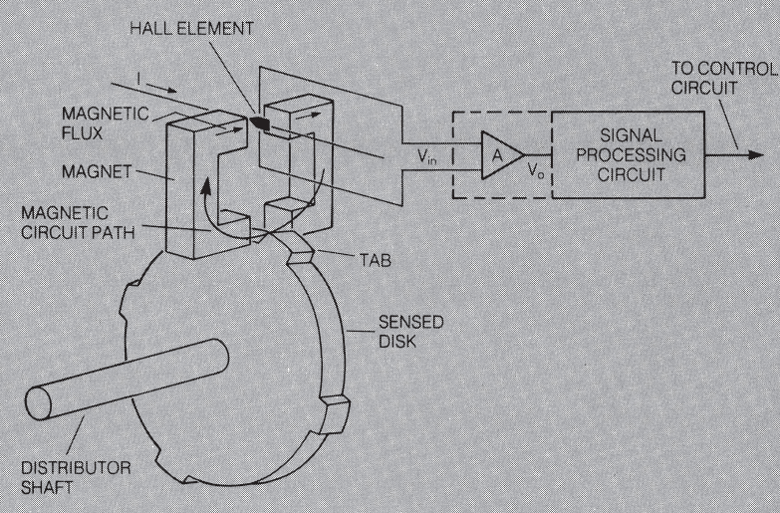
Hall-Effect Position Sensor

Slide 29
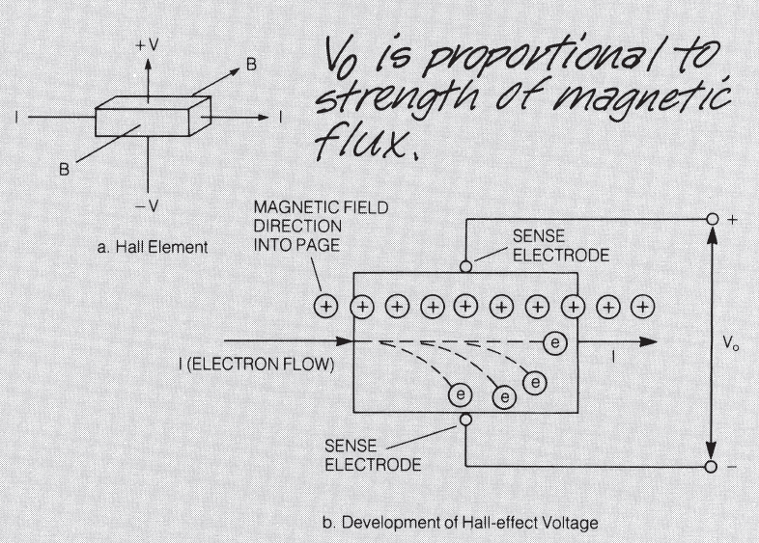
The Hall Effect

Slide 30
The Hall Effect
The Hall element is a small, thin, flat slab of semiconductor material.
When a current, I, is passed through this slab by means of an external circuit, a voltage is developed across the slab perpendicular to the direction of current flow and perpendicular to the direction of magnetic flux.
This voltage is proportional to both the current and magnetic flux density that flows through the slab.
This effect—the generation of a voltage that is dependent on a magnetic field—is called the Hall effect.

Slide 31
The current, I, is represented by electrons, e, which have negative charge, flowing from left to right.
The magnetic flux flows along the legs of the magnet as indicated and is generally perpendicular to the face of the semiconductor Hall element.
Whenever an electron moves through a magnetic field, a force (called the Lorentz force) that is proportional to the electron velocity and the strength of the magnetic flux is exerted on the electron. The direction of this force is perpendicular to the direction in which the electron is moving.
The Lorentz force direction is such that the electrons are deflected toward the lower sense electrode.
Thus, this electrode is more negative than the upper electrode and a voltage exists between the electrodes, having the polarity shown in Figure

Slide 32
As the strength of the magnetic flux density increases, more of the electrons are deflected downward.
If the current, I, is held constant, then the voltage, Vo, is proportional to the strength of the magnetic flux density, which,in turn, is determined by the position of the tabs.
This voltage tends to berelatively weak so it is amplified, as shown in Figure.

Slide 33
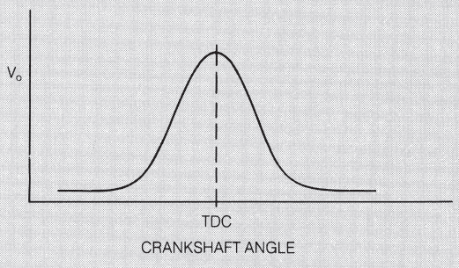
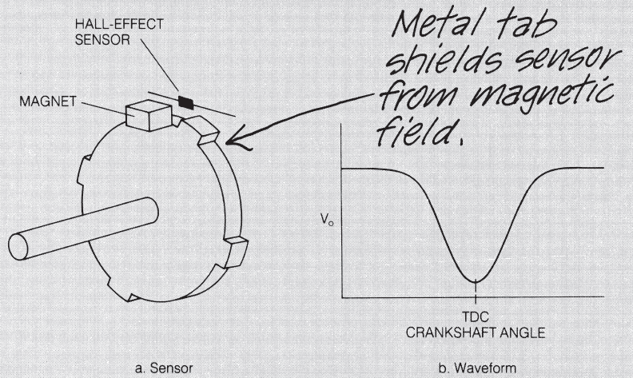
Waveform of Hall
Element Output
Voltage for Position
Sensor
Hall-Effect Position
Sensor That Shields
the Magnetic Circuit

Slide 34
Optical Crankshaft Position Sensor
In a sufficiently clean environment a shaft position can also be sensed using optical techniques.

Slide 35
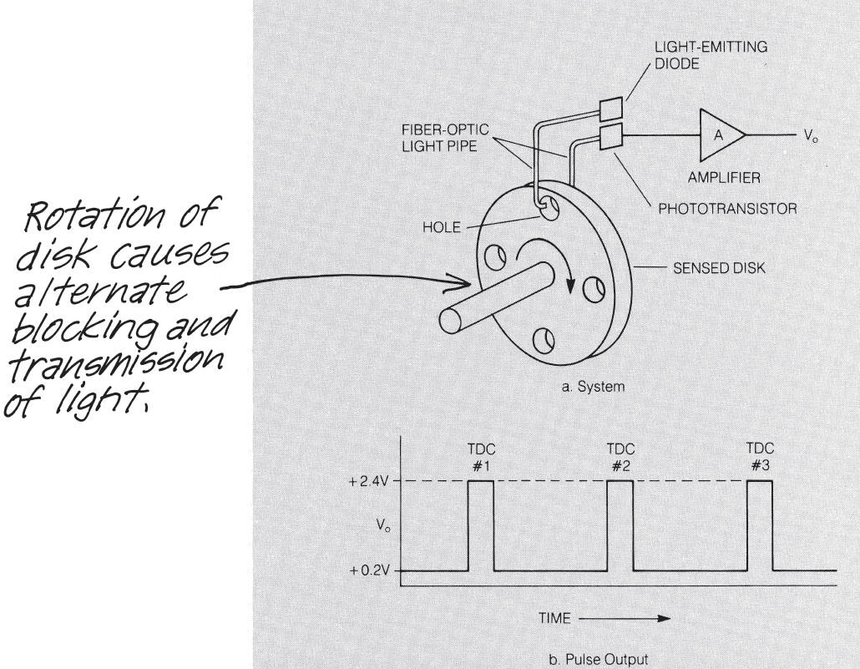

Slide 36
Again, as with the magnetic system, a disk is directly coupled to the crankshaft.
This time, the disk has holes in it that correspond to the number of tabs on the disks of the magnetic systems.
Mounted on each side of the disk are fiber-optic light pipes.
The hole in the disk allows transmission of light through the light pipes from the light-emitting diode (LED) source to the phototransistor used as a light sensor.
Light would not be transmitted from source to sensor when there is no hole because the solid disk blocks the light.

Slide 37
The pulse of light is detected by the phototransistor and coupled to an amplifier to obtain a satisfactory signal level.
The output pulse level can very easily be standard transistor logic levels of + 2.4 V for the high level and + 0.8 V for the low level.
One of the problems with optical sensors is that they must be protected from dirt and oil; otherwise, they will not work properly.
They have the advantages that they can sense position without the engine running and that the pulse amplitude is constant with variation in speed.

Slide 38
MAP Sensor Concepts
It is interesting to note that none of the MAP sensors in use measures manifold pressure directly, but instead measure the displacement of a diaphragm that is deflected by manifold pressure.
One relatively inexpensive MAP sensor configuration is the silicon diaphragm diffused strain gauge sensor.

Slide 39
Strain Gauge MAP Sensor
This sensor uses a silicon chip that is approximately 3 millimeters square.
Along the outer edges, the chip is approximately 250 micrometers (1 micrometer = 1 millionth of a meter) thick, but the center area is only 25 micrometers thick and forms a diaphragm.
The edge of the chip is sealed to a Pyrex plate under vacuum, thereby forming a vacuum chamber between the plate and the center area of the silicon chip.

Slide 40
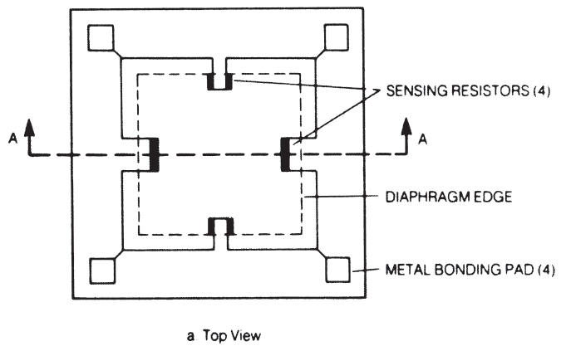
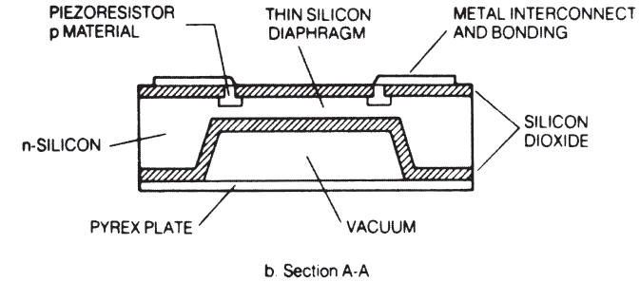
Silicon-
Diaphragm Strain
Gauge MAP Sensor

Slide 41
A set of sensing resistors is formed around the edge of this chamber, as indicated in Figure.
The resistors are formed by diffusing a doping impurity into the silicon. External connections to these resistors are made through wires connected to the metal bonding pads.
This entire assembly is placed in a sealed housing that is connected to the intake manifold by a small diameter tube. Manifold pressure applied to the diaphragm causes it to deflect.
The resistance of the sensing resistors changes in proportion to the applied manifold pressure by a phenomenon that is known as piezoresistivity.

Slide 42
Piezoresistivity occurs in certain semiconductors so that the actual resistivity (a property of the material) changes in proportion to the strain (fractional change in length).
The strain induced in each resistor is proportional to the diaphragm deflection, which, in turn, is proportional to the pressure on the outside surface of the diaphragm. This pressure is the manifold pressure.
An electrical signal that is proportional to the manifold pressure is obtained by connecting the resistors in a circuit called a Wheatstone bridge, as shown.

Slide 43
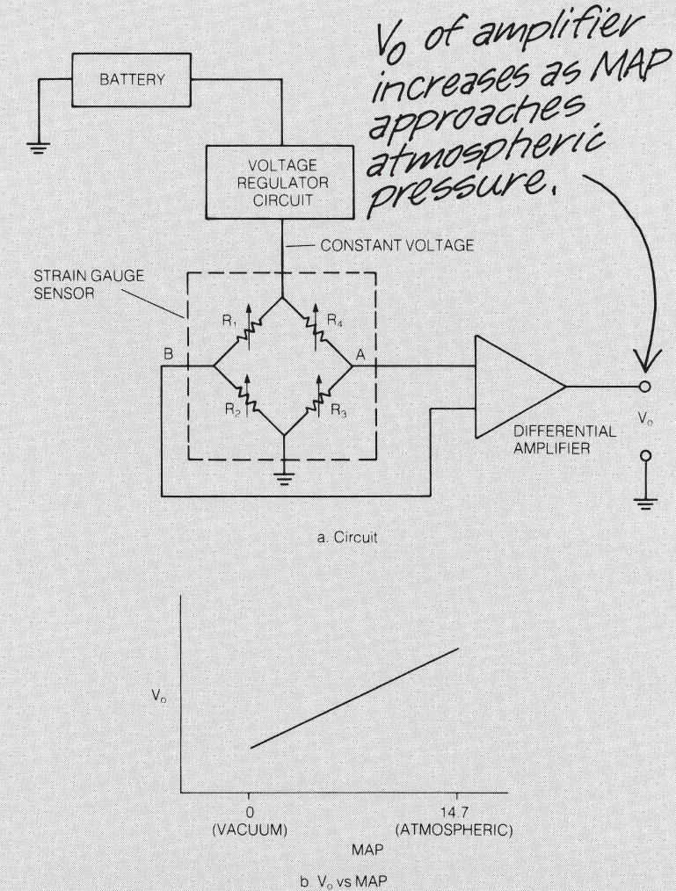
Circuit Diagram
for MAP Sensor
Using Strain
Gauges

Slide 44
The voltage regulator holds a constant dc voltage across the bridge. The resistors diffused into the diaphragm are denoted R1, R2, R3, and R4.
When there is no strain on the diaphragm, all four resistances are equal, the bridge is balanced, and the voltage between points A and B is zero.
When manifold pressure changes, it causes these resistances to change in such a way that R1 and R3 increase by an amount that is proportional to pressure; at the same time, R2 and R4 decrease by an identical amount.
This unbalances the bridge and a net difference voltage is present between points A and B.
The differential amplifier generates an output voltage proportional to the difference between the two input voltages.

Slide 45
THROTTLE ANGLE SENSOR
The throttle plate is linked mechanically to the accelerator pedal. When the driver depresses the accelerator pedal, this linkage causes the throttle plate angle to increase, allowing more air to enter the engine and thereby increasing engine power.
Measurement of the instantaneous throttle angle is important for control purposes, most throttle angle sensors are essentially potentiometers.
A potentiometer consists of a resistor with a movable contact, as illustrated in Figure

Slide 46
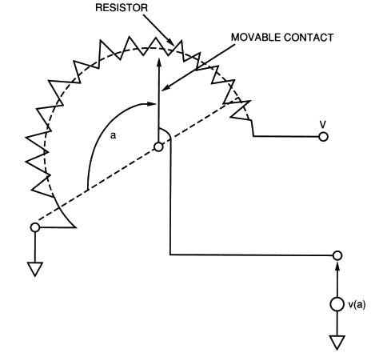
A section of resistance material is placed in an arc around the pivot axis for the movable contact. One end of the resistor is connected to ground, the other to a fixed voltage V
Throttle Angle Sensor: A Potentiometer

Slide 47
The voltage at the contact point of the movable contact is proportional to the angle (a) from the ground contact to the movable contact. Thus,
v(a)= ka
where v(a) is the voltage at the contact point,
k is a constant, and
a is the angle of the contact point from the ground connection.
This potentiometer can be used to measure any angular rotation. In particular, it is well suited for measuring throttle angle. The only disadvantage to the potentiometer for automotive applications is its analog output.
For digital engine control, the voltage v(a) must be converted to digital format using an analog-to-digital converter.

Slide 48
TEMPERATURE SENSORS
Temperature is an important parameter throughout the automotive system.
In operation of an electronic fuel control system it is vital to know the temperature of the coolant, the temperature of the inlet air, and the temperature of the exhaust gas oxygen sensor

Slide 49
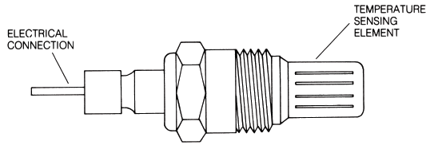
Coolant Sensor
Consists of a thermistor mounted in a housing that is designed to be inserted in the coolant stream.
This housing is typically threaded with pipe threads that seal the assembly against coolant leakage.
A thermistor is made of semiconductor material whose resistance varies inversely with temperature. For example, at -40°C a typical coolant sensor has a resistance of 100 Kohms. The resistance decreases to about 70 Kohms at 130°C.

Slide 50
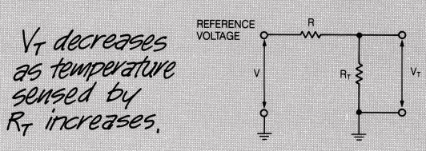
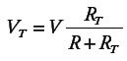
The sensor is typically connected in an electrical circuit as shown.
The coolant temperature sensor resistance is denoted R_{T}. This resistance is connected to a reference voltage through a fixed resistance R. The sensor output voltage V_{T}, is given by the following equation:
The sensor output voltage varies inversely with temperature; that is, the output voltage decreases as the temperature increases.

Slide 51
SENSORS FOR FEEDBACK CONTROL
Feedback control for fuel delivery is based on maintaining the air/fuel ratio at stoichiometry (i.e., 14.7 : 1).
The primary sensor for fuel control is the exhaust gas oxygen sensor.

Slide 52
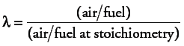
Exhaust Gas Oxygen Sensor
The amount of oxygen in the exhaust gas is used as an indirect measurement of the air/fuel ratio.
As a result, one of the most significant automotive sensors in use today is the exhaust gas oxygen (EGO) sensor.
This sensor is often called a lambda (λ) sensor
Whenever the air/fuel ratio is at stoichiometry, the value for λ is 1.
When the air–fuel mixture is too lean, the condition is represented (denoted λ > 1).
Conversely, when the air–fuel mixture is too rich, the condition is represented by (λ < 1).

Slide 53
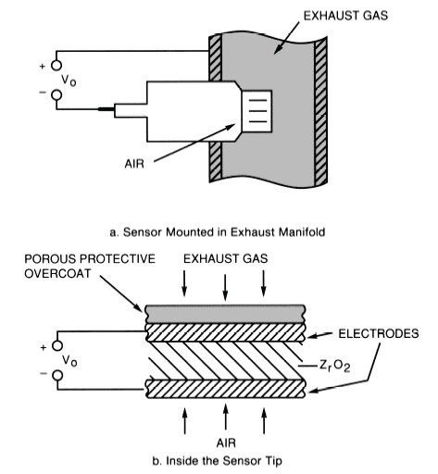
The two types of EGO sensors that have been used are based on the use of active oxides of two types of materials.
One uses zirconium dioxide (ZrO₂) and the other uses titanium dioxide (TiO₂). The former is the most commonly used type today.

Slide 54
Figure indicates that a voltage Vo,is generated across the ZrO₂ material. This voltage depends on the exhaust gas oxygen concentration, which in turn depends on the engine air/fuel ratio.
In essence, the EGO sensor consists of a thimble-shaped section of ZrO₂ with thin platinum electrodes on the inside and outside of the ZrO₂. The inside electrode is exposed to air, and the outside electrode is exposed to exhaust gas through a porous protective overcoat.

Slide 55
EGO sensor operation is based on the distribution of oxygen ions. An ion is an electrically charged atom.
Oxygen ions have two excess electrons and each electron has a negative charge; thus, oxygen ions are negatively charged.
The ZrO₂ has a tendency to attract the oxygen ions, which accumulate on the ZrO₂ surface just inside the platinum electrodes.
The air reference side becomes electrically more negative than the exhaust gas side; therefore, an electric field exists across the ZrO₂ material and a voltage, Vo, results.
The magnitude of this voltage depends on the concentration of oxygen in the exhaust gas and on the sensor temperature.

Slide 56
The quantity of oxygen in the exhaust gas is represented by the oxygen partial pressure.
The exhaust gas oxygen partial pressure for a rich mixture varies over the range of 10⁻¹⁶ to 10⁻³² of atmospheric pressure. The oxygen partial pressure for a lean mixture is roughly 10⁻² atmosphere.
Consequently, for a rich mixture there is a relatively low oxygen concentration in the exhaust and a higher EGO sensor output.
Correspondingly, for a lean mixture the exhaust gas oxygen concentration is relatively high, resulting in a relatively low EGO sensor output voltage.

Slide 57
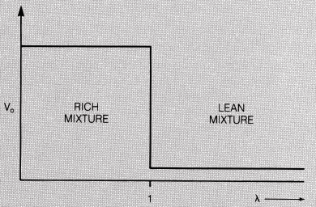
For a fully warmed EGO sensor the output voltage is about 1 volt for a rich mixture and about 0.1 volt for a lean mixture.

Slide 58
Knock Sensors
This sensor is employed in closed-loop ignition timing to prevent undesirable knock.
Due to rapid rise in cylinder pressure during combustion, this does not occur normally, but only under special conditions.
It occurs most commonly with high manifold pressure and excessive spark advance.
It is important to detect knock and avoid excessive knock; otherwise, there may be damage to the engine.

Slide 59
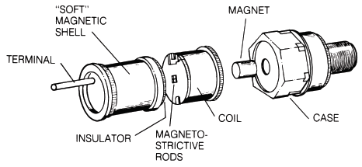
One way of controlling knocking is to sense when knocking begins and then retard the ignition until the knocking stops.
A key to the control loop for this method is a knock sensor.
A knock sensor using magnetostrictive techniques as shown

Slide 60
Magnetostriction is a phenomenon whereby the magnetic properties of a material depend on stress (due to an applied force).
When sensing knock, the magnetostrictive rods, which are in a magnetic field, change the flux field in the coil due to knock-induced forces.
This change in flux produces a voltage change in the coil. This voltage is used to sense excessive knock

Slide 61
ACTUATORS

Slide 62
An actuator is a device that receives an electrical input (from the engine controller) and produces a mechanical or thermal (or other) output.
Examples of actuators include various types of electric motors, solenoids, and piezoelectric force generators.
The solenoid is used in applications ranging from precise fuel control to applications such as electric door locks.

Slide 63
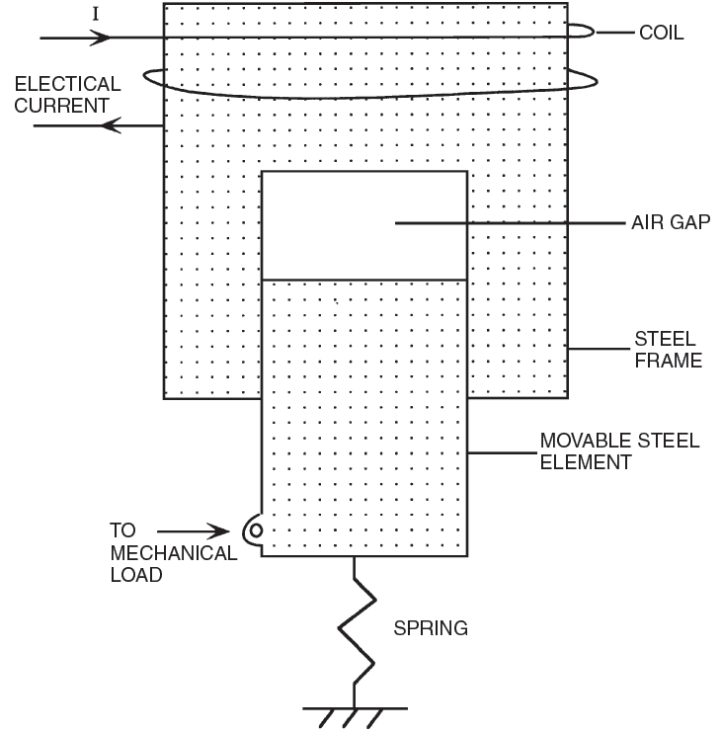
Schematic Drawing of
a Solenoid

Slide 64
The solenoid consists of a fixed steel (i.e.,ferromagnetic) frame with a movable steel element.
A spring holds the movable element in position such that there is a gap between the end of the movable element and the opening in the frame.
A coil is wound around the steel frame, forming a powerful electromagnet
When a current passes through the coil, a magnetic field is created that tends to pull the movable element toward the steel frame.
When the magnetic field, which is proportional to the current, is sufficient to overcome the force at the spring holding the movable element, then it begins to move toward the frame.

Slide 65
As this element moves, the size of the gap is reduced, causing an increase in the strength of the magnetic field.
This increase causes the movable element to accelerate toward the frame until it reaches the stop.
This abrupt motion of the movable element is essentially in the form of a mechanical switching action such that the solenoid tends to be either in its rest position (as held by the spring) or against the mechanical stop.
Applications of solenoids in automotive electronics include fuel injectors and EGR valves.

Slide 66
Fuel Injection
A fuel injector is a solenoid-operated valve. The valve opens or closes to permit or block fuel flow to the engine.
The valve is attached to the movable element of the solenoid and is switched by the solenoid activation

Slide 67
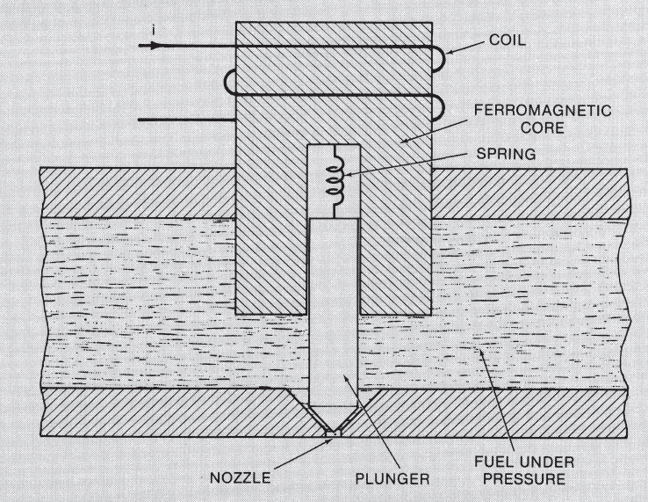
Schematic Drawing of Fuel Injector

Slide 68
In a fuel injector with no current flowing, the solenoid movable element is held down against the stop, covering the aperture or nozzle.
Fuel is thereby blocked from flowing from the pressurized fuel chamber into the aperture.
When current flows through the solenoid coil, the movable element is switched upward, the aperture is exposed, and fuel (under pressure) sprays through this aperture.
The fuel flow rate through the nozzle is constant for a given regulated fuel pressure and nozzle geometry; therefore, the quantity of fuel injected into the air stream is proportional to the time the valve is open.
The control current that operates the fuel injector is pulsed on and off to deliver precise quantities of fuel.

Slide 69
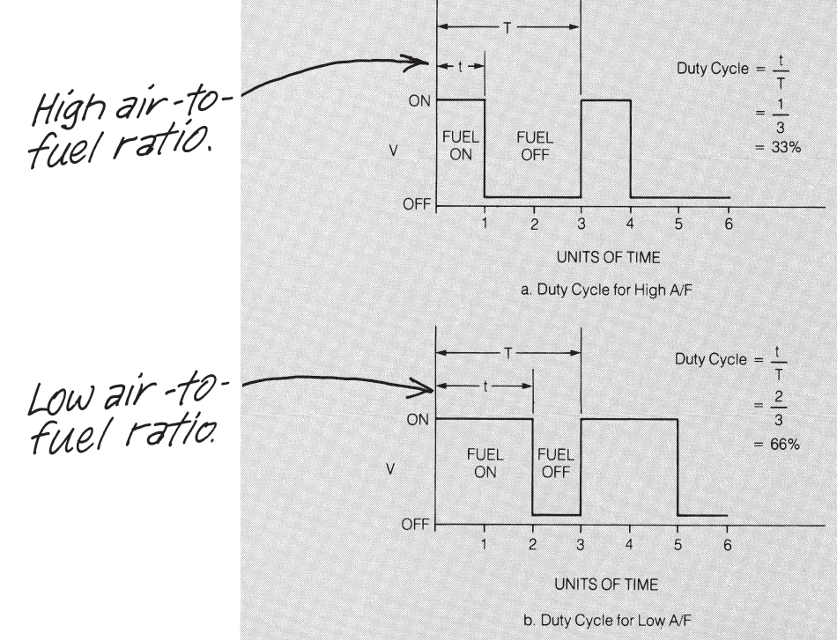

Slide 70
Exhaust Gas Recirculation Actuator
Exhaust gas recirculation (EGR) is utilized to reduce NOx emissions.
The amount of EGR is regulated by the engine controller, when the correct amount of EGR has been determined by the controller based on measurements from the various engine control sensors, the controller sends an electrical signal to the EGR actuator.
Typically, this actuator is a variable-position valve that regulates the EGR as a function of intake manifold pressure and exhaust gas pressure.

Slide 71
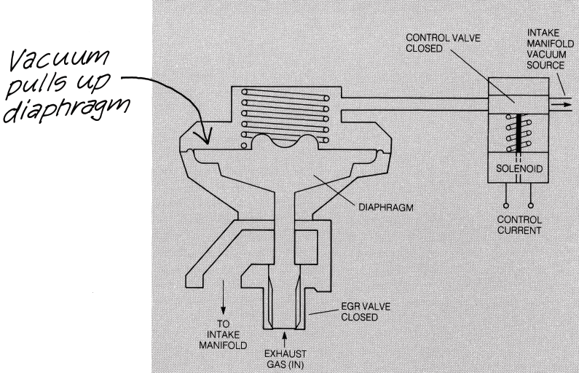
EGR Actuator Control

Slide 72
This actuator is a vacuum-operated diaphragm valve with a spring that holds the valve closed if no vacuum is applied.
The vacuum that operates the diaphragm is supplied by the intake manifold and is controlled by a solenoid operated valve. This solenoid valve is controlled by the output of the control system.
Whenever the solenoid is energized (i.e., by current supplied by the control system flowing through the coil), the EGR valve is opened by the applied vacuum.
The amount of valve opening is determined by the average pressure on the vacuum side of the diaphragm.

Slide 73
This pressure is regulated by pulsing the solenoid with a variable-duty-cycle electrical control current.
The duty cycle of this pulsing current controls the average pressure in the chamber that affects the diaphragm deflection, thereby regulating the amount of EGR.

Slide 74
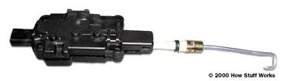
This actuator can move the metal hook shown in this photo to the left or right. When mounted in the car, it is vertical, so the hook can move up or down. It mimics your motions when you pull the knob up or push it down.

Slide 75
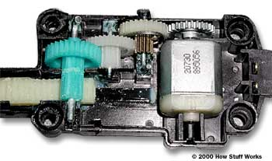
Inside the power-door-lock actuator
This system is quite simple. A small electric motor turns a series of spur gears that serve as a gear reduction. The last gear drives a rack-and-pinion gearset that is connected to the actuator rod. The rack converts the rotational motion of the motor into the linear motion needed to move the lock.

Slide 76
When the motor spins the gear, the clutch swings out and locks the small metal gear to the larger plastic gear, allowing the motor to drive the door latch. If you move the door latch yourself, all of the gears will turn except for the plastic gear with the clutch on it.

